Slide 1
Diabetes prediction
By:
Priyanka S K

Slide 2
.
Introduction to Machine Learning
In machine learning, computers apply statistical
learning techniques to automatically identify patterns in
data. These techniques can be used to make highly
accurate predicttions.

Slide 3
Back Diabetes and Machin Learning use:
Diabetes is one of deadliest diseases in the world. It is not only a disease but also a creator of different kinds of diseases like heart attack, blindness, kidney diseases, etc.
The normal identifying process is that patients need to visit a diagnostic center, consult their doctor, and sit tight for a day or more to get their reports.
Moreover, every time they want to get their diagnosis report, they have to waste their money in vain
Diabetes Mellitus (DM) is defined as a group of metabolic disorders mainly caused by abnormal insulin secretion and/or action. Insulin deficiency results in elevated blood glucose levels (hyperglycemia) and impaired metabolism of carbohydrates, fat and proteins.
DM is one of the most common endocrine disorders, affecting more than 200 million people worldwide. The onset of diabetes is estimated to rise dramatically in the upcoming years.

Slide 4
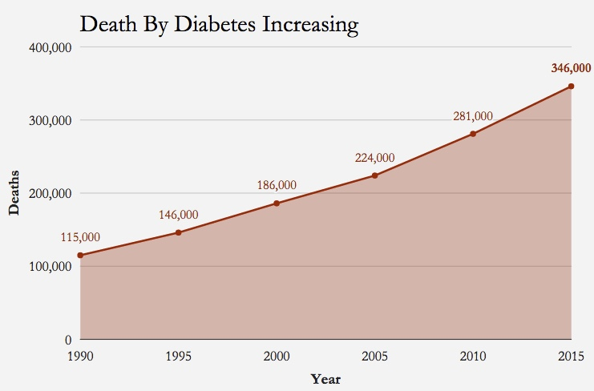
Death rate due to diabetes:
Deaths due to diabetes accounted for 3.1% (95% uncertainty interval [UI]: 2.9–3.3) of all deaths in India in 2016, up from 0.98% (95% UI: 0.87–1.1) of all deaths in 1990.
Diabetes and hyperglycemia accounted for 27.5 million disability-adjusted life years in 2016, of which diabetes accounted for 10 million.
Diabetes contributes to the causation of ischemic heart disease, stroke, CKD, peripheral artery disease, specific cancers, and tuberculosis via intermediate hyperglycemia.
High body mass index, dietary factors (diet low in fruits, nuts and seeds, and whole grains), and tobacco use were the most important risk factors for diabetes.

Slide 7
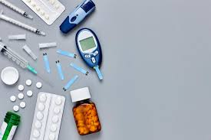
Problem Statement:
Machine learning is the scientific field dealing with the ways in which machines learn from experience. The purpose of machine learning is the construction of computer systems that can adapt and learn from their experience.
Here is the Project based on Machine learning to help the people to predict the Diabetes before going for the medical check-ups.
This prediction will be based on some of the attributes like glucose level of the body, insulin, whether the patient have diacetates during the pregnancy?, etc.
The attributes which we are using is here is all numeric values.
The output of the prediction includes whether the person is diabetic or not. It will be in the format of 0 and 1.
where as 1 means the person is affected by the diabetes,
0 means he is not affected.

Slide 8
Steps to solve the Machine learning Problem:
1. Strategy: matching the problem with the solution | 2. Dataset preparation and preprocessing 2.1Data collection 2.2Data visualization 2.3Labeling 2.4Data selection 2.5Data preprocessing 2.5.1Data formatting. 2.5.2Data cleaning. 2.5.3Data anonymization. 2.5.4Data Sampling. 2.6Data transformation 2.6.1Scaling 2.6.2Decomposition. 2.6.3Aggregation. | 3. Dataset splitting 3.1training sets. 3.2test sets. 3.3validation sets.
4. Modeling 4.1Model training 4.1.1supervised learning 4.1.2unsupervised learning. 4.2Model evaluation and testing 4.3Improving predictions with ensemble methods 4.3.1stacking. 4.3.2bagging. 4.3.3boosting. | 5. Model deployment | 6.Conclusion

Slide 9
Historical data:
The data which is collected is of almost covering
nine attributes.
All the data which is collected is in the
Numerical form.
The data which is collected, it is covering almost
all the possibilities by which the diabetes
can be caused and by which factor the doctors
predict the diabetes of the person.
The attributes which we are considering:
1. Pregnancies
2. Glucose
3. Blood Pressure
4. Skin Thickness
5. Insulin
6. BMI
7. Diabetes Pedigree Function
8. Age
9. Outcome

Slide 10
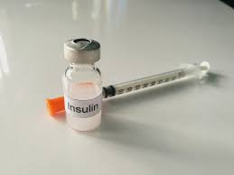
Expected output:
The expected output will be the person is diabetic or he is not diabetic. The output will be in the format of 0 and 1.
The output of the prediction includes whether the person is diabetic or not. It will be in the format of 0 and 1.
Where as 1 means the person is affected by the diabetes, 0 means he is not affected.

Slide 11
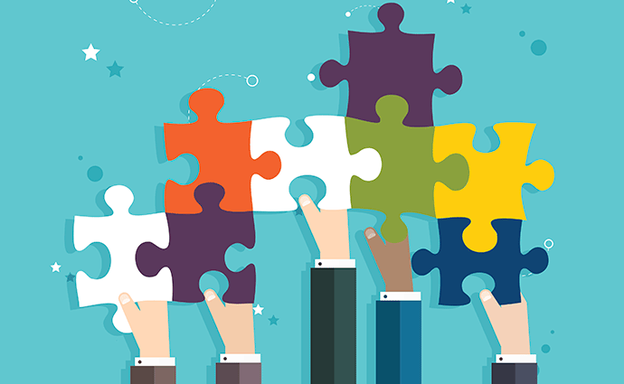
stakeholders(parties) impacted:
The parties involved in this project is Hospital people and normal people.
It will help Doctors to get to know easily whether the person is diabetic or not.
Now a days there are some medical tests to know that whether that person is diabetic or not. We are not saying that this project will give 100 % accurate results.
But, it can help people and doctors to predict diabetes for some extend.

Slide 12
Methodology to work:
There are many methodologies by which we can predict the diabetes.
The different methodology by which we tried are :
1.SVM
2.Decision tree
3. Logistic Regression
The methodology which worked perfect is Logistic regression.
The other two didn’t gave the much accuracy as compared with the Logistic regression.

Slide 13
Solution Description:
The attributes which we are using is here is all numeric Type.
The output of the prediction includes whether the person is diabetic or not. It will be in the format of 0 and 1. where as 1 means the person is affected by the diabetes, 0 means he is not affected. As we have seen in before slides.
Now the accuracy of the model which we have build:
We stared the project with how Machine learning is used in the field of Medical science.
Flowed by, we are doing the problem of Diabetic Prediction.
Based on applying several models I decided Logistic Regression as the best model.
The accuracy of this model is 0.818181818182
Where as decision tree model is 74.0259740297402 accuracy and svm is 0.7272727272727273 accurate.
By comparing all the models accuracy we took Logistic Regression as the best model.

Slide 14
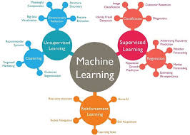
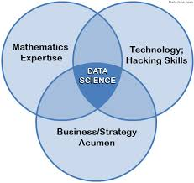
Lessons learnt:
The lessons I learnt through this project is how to build the different prediction models like SVM,Decision tree, Logistic Regression.
As we have started it with machine learning and how the machine learning is used in the field of medical science.

Slide 15
Thank you

